Slide 1
Why and how to peer review

Slide 2
Reciprocal altruism & THE Golden Rule
“Review for others as you would have others review for you.”
Be positive and constructive at all times
Support your criticisms or praise with concrete reasons that are well laid out and logical
“Terse, ill-informed reviews reflect badly on you.” The editor knows you.
Mark A. McPeek, Donald L. DeAngelis, Ruth G. Shaw, Allen J. Moore, Mark D. Rausher, Donald R. Strong, Aaron M. Ellison, Louise Barrett, Loren Rieseberg, Michael D. Breed, Jack Sullivan, Craig W. Osenberg, Marcel Holyoak and Mark A. Elgar (2009) The Golden Rule of Reviewing. The American Naturalist, 173, E155-E158.

Slide 3
“Being trusted to do a peer review is a privilege”
The difference between science and any other human endeavor is the concept of falsifiability
Peer review and the assessment of falsifiability is the cornerstone of science
It is the process by which the quality of our papers and proposals are assessed.
I have always depended on the kindness of strangers. (Blanche DuBois)

Slide 4
Three elements to writing a review
Write a (1-2 paragraph) summary of the paper and why it is important.
Ideally put the paper in context with a sentence or two to provide context on the state of knowledge.
“While intransitivity in competition was theoretically known to lead to unstable coexistence, here Sinervo & Lively have shown rock-paper-scissors in the wild for the first time.”
It is also fair to preface this with what is not novel. “From their initial confirmatory finding of x, the authors build to develop the novel finding y.”
Main points (number them keep to 3-8 maximum)
1. Page 1, column 1. The main premise of the paper is evidence for competition comes mainly from laboratory experiments, however, Connell 1975 showed that competition structures animal distributions in the field too…. Please rework the justification to accurately reflect older experiment literature on competition.
Minor points (number them)
1. Page 1, column 1, line 3. Replace “coll” with “cow” to read “how now brown cow”.

Slide 5
How to review 1/2
A sound approach may be to read the manuscript carefully from beginning to end before considering the review.
Then read the journal's Guide to Authors, particularly if you have not published in the journal yourself.

Slide 6
How to review 2/2
A sound approach may be to read the manuscript carefully from beginning to end before considering the review.
*Read a second time and make notes
Rewrite notes and divide into major and minor points
Insert location references for each point, e.g. “Line 332” or “page 12, paragraph 2, line 3”.
Summarize the paper and put it in context*
Reread your review to ensure the tone is constructive.

Slide 7
Things to pay attention to
Does the structure conform to journal guidelines?
Does the structure convey the message intended?
Is the scope consistent, does title match contents or overpromise?
Is there concrete signposting (Here, I review three hypotheses of amphibian diversity: (1) energy availability, (2) water availability, and (3) thermal stability.
Do the subheadings / topic sentences tell the story on their own?
Is there parallelism; does sequence & continuity of paragraphs match the sequence of layup?
Is there a clear take-home message?

Slide 8
Checklist
Add page numbers and line numbers
Be constructive, not destructive
You are not an author, be aware of the amount of time you wish to invest.
Divide into major and, minor issues
Should you sign off?

Slide 9
How long should I take?
How long would you like someone to spend reviewing your paper?

Slide 10
Real examples
This appears to be an excellent MS that tackles some important issues. However, there are elements of the presentation that need considerable work to ensure that the ideas and findings are communicated effectively.
I have major issues with the structure and content of the Introduction, statistical modeling, and description of methods and the presentation of the graphical results. I spent considerable time directing the authors toward a more defensible and readable MS.
1. TITLE: The title doesn’t reflect the narrow scope of the work. I was expecting a global synthesis across a range of habitats. Instead, this paper focused on body temperatures of one species in a few locations. The title needs to not overpromise.

Slide 11
This MS summarizes a timely and rapidly developed web-questionnaire designed to draw upon the large and untapped diver knowledge of XXXX fish distribution and status. It has two other peripheral elements of minor novelty compared to the diver survey.
1. My main recommendation is that the XXXXX survey findings be laid out more clearly and should be better contextualized.

Slide 12
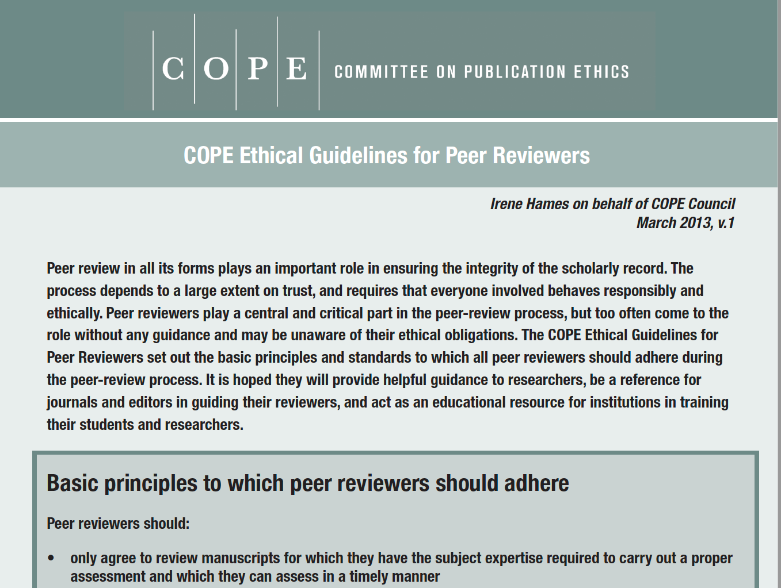
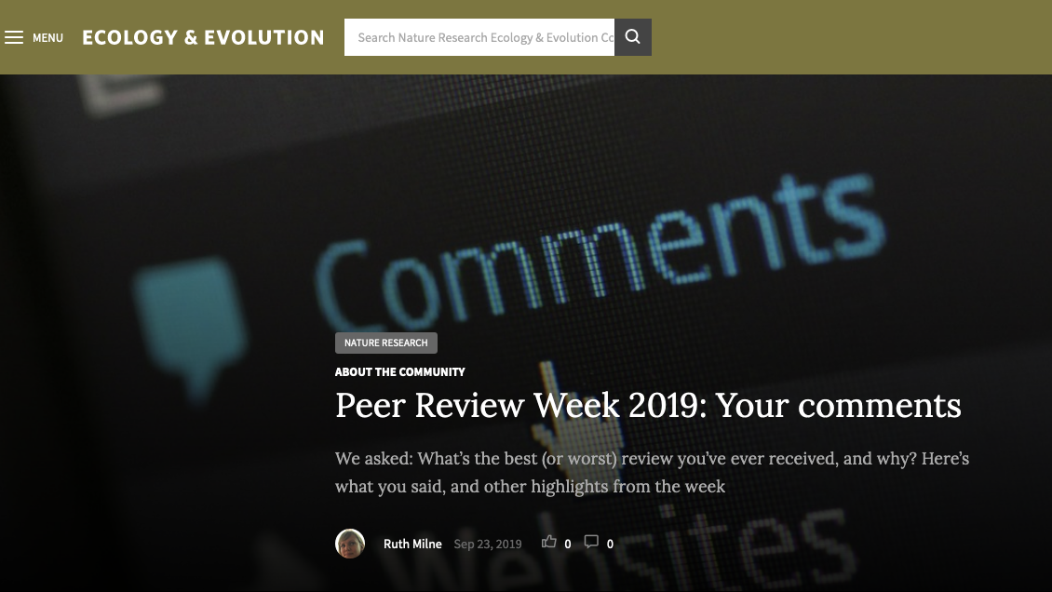
Resources

Slide 13
Some general rules (worth bearing in mind but not needed for TREE review)
Rule 1: Do not accept a review assignment unless you can accomplish the task in the requested timeframe—learn to say no
Bourne, P. E. and Korngreen, A. (2006) Ten Simple Rules for Reviewers.
PLoS Comput Biol, 2, e110.

Slide 14
Rule 2: Avoid conflict of interest
The cloak of anonymity is not intended to cover scientific misconduct. Do not take on the review if there is the slightest possibility of conflict of interest, e.g.
professional or personal benefit
professional or personal relationship with an applicant or the applicant’s institution
direct or indirect financial interest

