Slide 1
How to write an Economist article

Slide 2
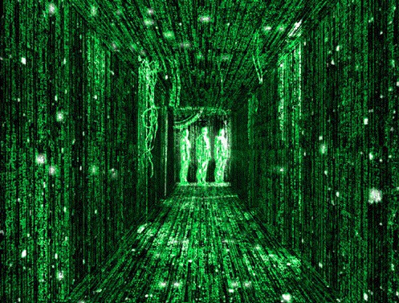
The structure is a simple formula

Slide 3
The structure is a simple formula
Paragraph | What is it about?
First | Lure the reader in with a connection to the wider world, get the reader into WHAT and WHY should we care?
Second | WHO (and ends with headline result) maybe a WHERE & WHEN
Third | HOW #1 (what was the data, elements of WHEN/WHERE)
Fourth | HOW #2 (what was the opportunity – experiment, natural history, contrast)
Fifth | HOW #3 (deeper dive into methodology, needed to understand result) ending with detail of the finding
Sixth | Discussion of the finding, alternate explanations
Seventh | Conclusion, what does this mean, why should we care?

Slide 4
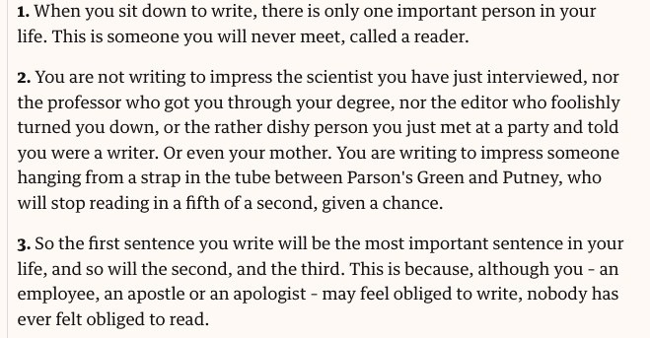
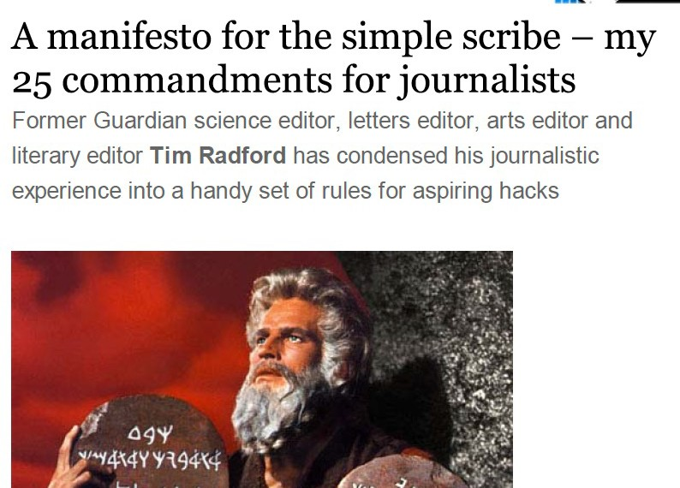
https://www.theguardian.com/science/blog/2011/jan/19/manifesto-simple- scribe-commandments-journalists

Slide 5
The simplest rule of storytelling 5W&H
WWWWW

Slide 7
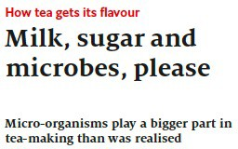
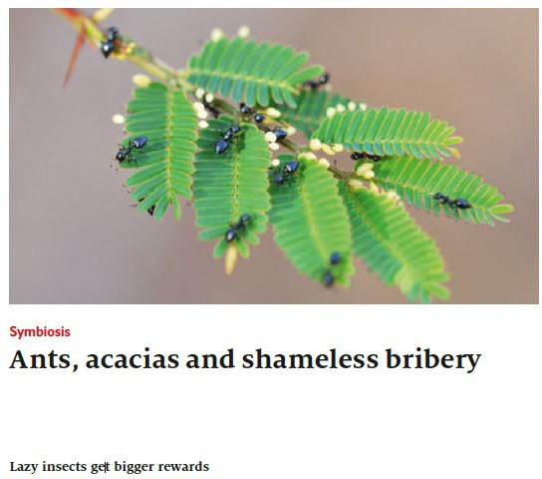
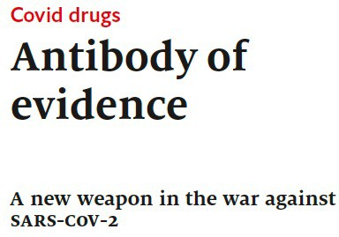
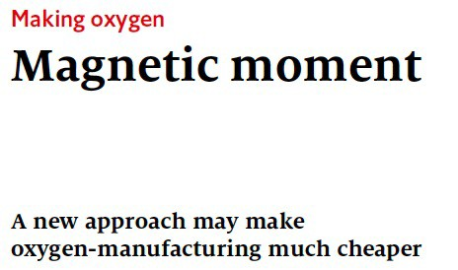
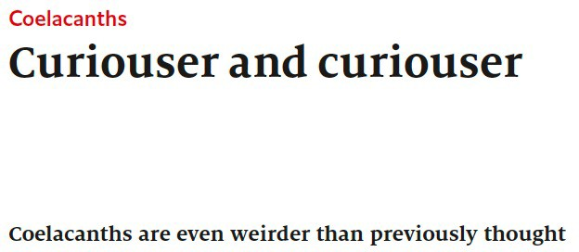
Titles

Slide 8
First Paragraph – lure in the audience
“although you may feel obliged to write, nobody has felt obliged to read”
Notice ‘Conspicuous consumption’, ‘Price’ these are economic terms and concepts
Familiar terms, concepts, ideas, idioms, fables and narratives are used to introduce you to a new topic. Note the pivot from Economics to Ecology is quite arresting and draws the reader in.
Conspicuous consumption has its price,
at least in the avian world
Why should the reader care about this?

Slide 9
First Paragraph – lure in the audience
Second sentence: what did we know before?
The hypothesis
Third sentence: What did we know before? Add a layer of detail Closing sentence: What’s the level/nature of support

Slide 10
First Paragraph – lure in the audience
Second sentence: what did we know before?
A hypothesis
Third sentence: What did we know before?
Add a layer of detail, in this case it is the theoretical expectations
Closing sentence: What’s the level/nature of support

Slide 11
First Paragraph – lure in the audience
Second sentence: what did we know before?
A hypothesis
Third sentence: What did we know before?
Add a layer of detail, in this case it is the theoretical expectations Closing sentence: What’s the level/nature of support.
Notice the way it is written.
Contrast with how we would we write this formally in paper

Slide 12
Second Paragraph – What’s the new study?
Specifically, Who, Where, What did they find
Don’t be afraid to follow this formula, exactly.
Notice the placement of the punchline… why is it here, where does it occur in papers?

Slide 13
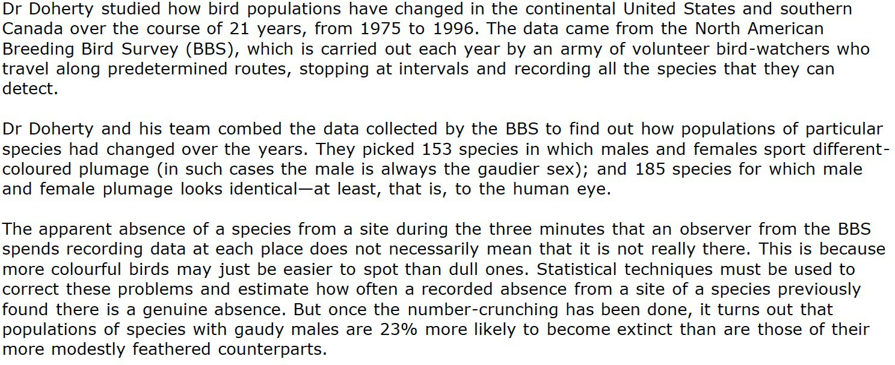
Third, Fourth and Fifth paragraphs –
What is the formula here?

Slide 14
Sixth paragraph – what’s the pattern
Also -- what didn’t the author write about?

Slide 15
Final paragraph
What is the formula here?

Slide 16
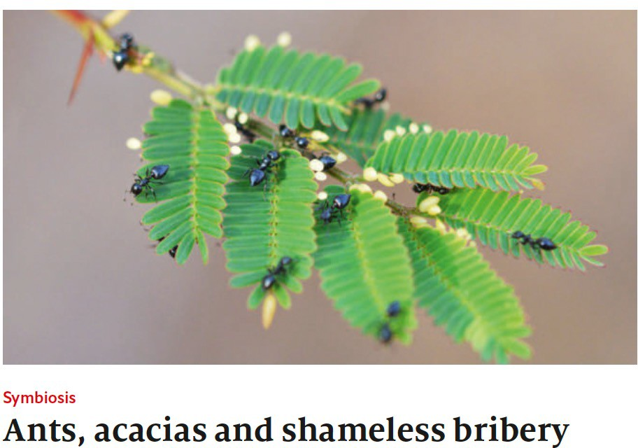
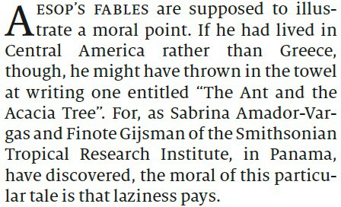
Comments:

Slide 17
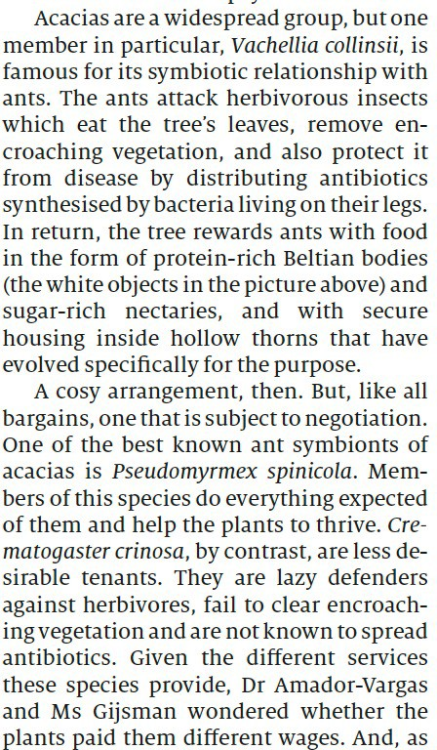
Paragraph 2 & 3
Comments:

Slide 18
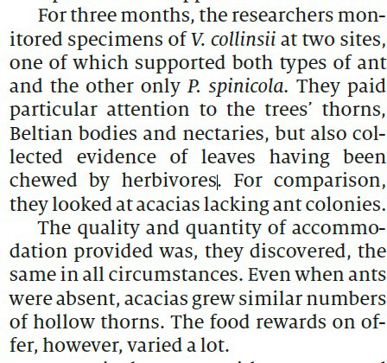
Paragraphs 4 & 5
Comments:

Slide 19
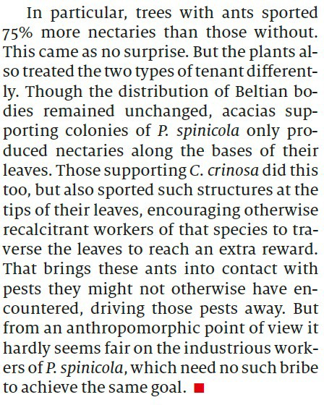
Final paragraph
How does this differ from the the final paragraph of the Doherty write-up? What is the tweet of this paper?
Comments:

Slide 20
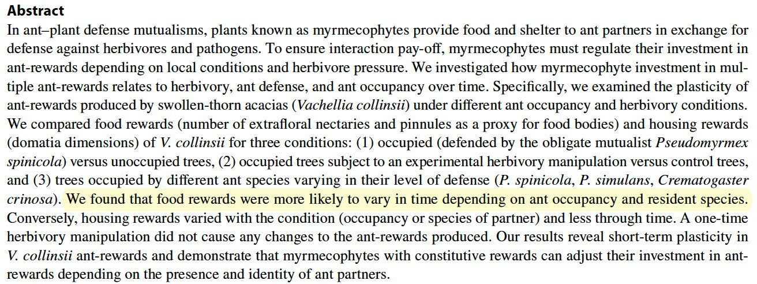
Note the abstract of this paper is sparse and vague on the results
We found that something varies with something and something else.

Slide 21
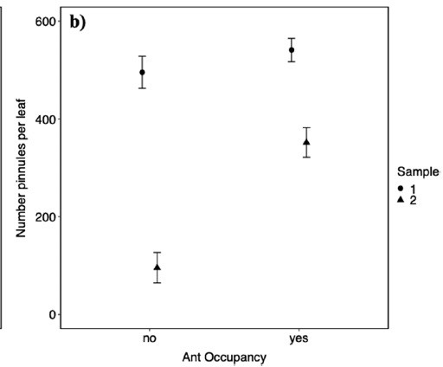
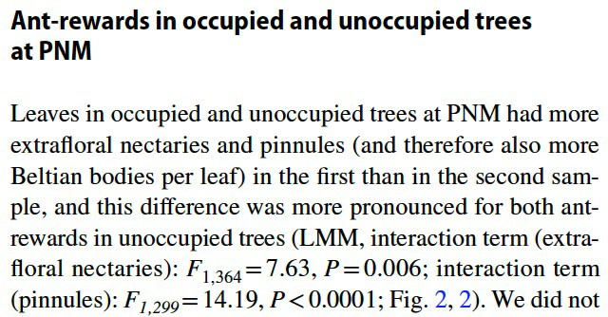
Notice the mode of inference
The authors search for statistically significant DIFFERENCES rather than focusing on the EFFECT SIZE

Slide 22
How to choose a paper
Be kind on yourself and others and consider higher-ranking journals,
Ecology Letters, Conservation Letters, Proceedings of Royal Society, B Biological Sciences, PNAS (Proceedings of National Academy of science USA), Nature, Science, Current Biology, any others???
Avoid big sprawling papers, e.g., American Naturalist, Ecological Monographs, etc.
Avoid narrative reviews but consider metanalyses and other quantitative syntheses.
One litmus test - If you can’t write a tweet/X about it then consider finding another paper.

