Slide 1
BISC 830 Community Ecology and Macroecology Course Logistics

Slide 2
BISC 830 Community Ecology and Macroecology Course Logistics
Course web site
http://www.dulvy.com/community-ecology--macroecology-bisc-830.html
More details on assignments
http://www.dulvy.com/bisc-830-assignments.html

Slide 3
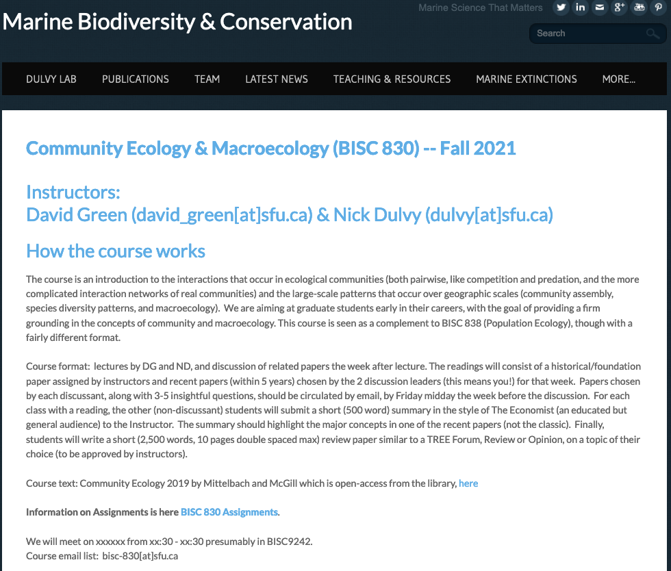

Slide 4
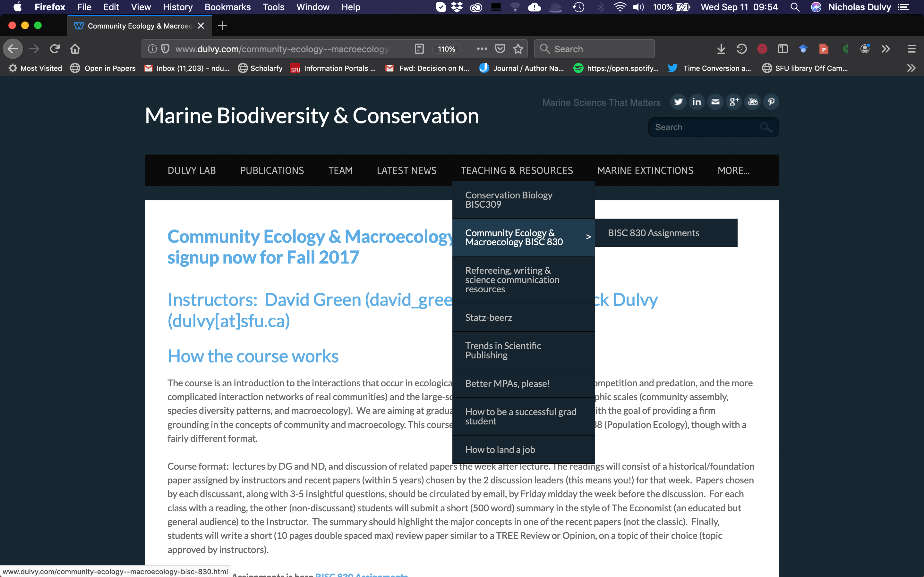

Slide 5
Plan for today
Introductions
Pick meeting time/date
Highlight Economist readings / papers
Think about which Discussion topic to lead
The book

Slide 6
Introductions

Slide 7
When to meet
Ideally Wed
Thursday after Les Ecologists 1230-1330
Priority to accommodate those TAing and taking courses

Slide 8
What to do for next class
Read both Economist articles and the related papers (ideally paper first, then article)
Think about which two discussions you wish to lead
Read Chp 2 Patterns of Biological Diversity

Slide 9
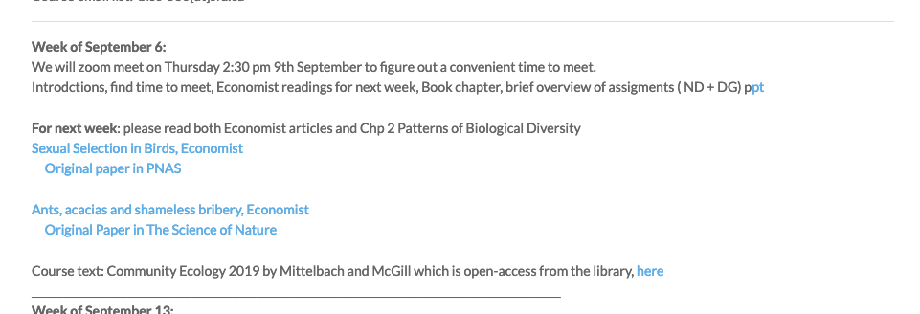
What to do for next class
Read both Economist articles and the related papers (ideally paper first, then article)

Slide 10
What’s this Economist assignment all about?
See http://www.dulvy.com/bisc-830-assignments.html

Slide 11
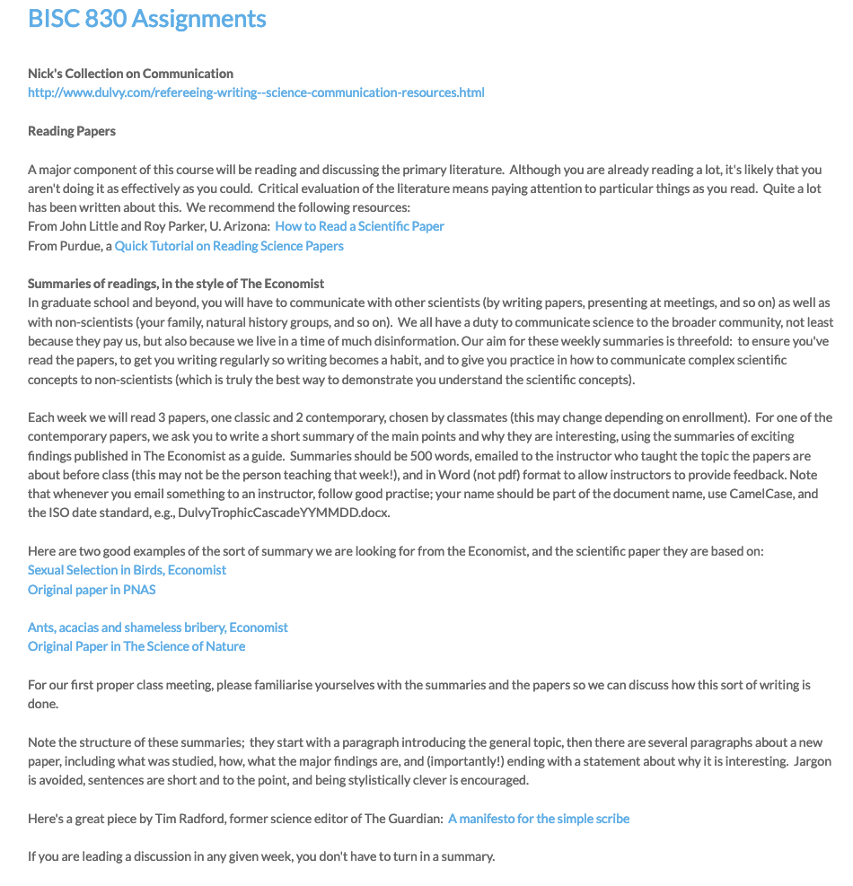

Slide 12
Main things in here
How to read a paper
Summarising a paper in style of Economist
How to lead a discussion
The TREE Forum paper
How to peer-review a paper

Slide 13
What to do for next class
Read both Economist articles and the related papers (ideally paper first, then article)
Think about which two discussions you wish to lead
Read Chp 2 Patterns of Biological Diversity

Slide 14
Lecture | Discussion topics | Week of Discussion
Spatial patterns of diversity | Diversity patterns | Sept 20
Interactions 1: niche, resources, competition & coexistence (DG) | Competition | Sept 27
Interactions 2: predators, prey, stability, cycles, feedback & coexistence | Predation | Oct 4
Direct & Indirect interactions, trophic cascades | Trophic cascades | Oct 11
Food webs/networks | Food webs/networks | Oct 18
Succession and community assembly | Succession and community assembly | Oct 25
Neutrality | Neutrality | Nov 01
Trait-based community ecology | Trait-based community ecology | Nov 8
Biodiversity and Ecosystem function | BD-EF | Nov 15

Slide 15
Discussion leaders | Discussion topics | Week of Discussion
 | Diversity patterns | Sept 20
 | Competition | Sept 27
 | Predation | Oct 4
 | Trophic cascades | Oct 11
 | Food webs/networks | Oct 18
 | Succession and community assembly | Oct 25
 | Neutrality | Nov 01
 | Trait-based community ecology | Nov 8
 | BD-EF | Nov 15

Slide 16
What to do for next class
Read both Economist articles and the related papers (ideally paper first, then article)
Think about which two Discussion you wish to lead
Read Chp 2 Patterns of Biological Diversity

Slide 17
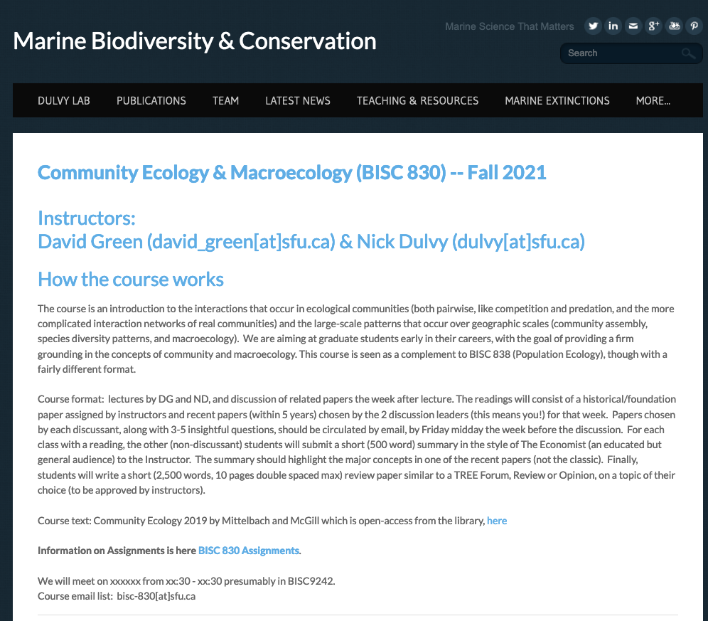
Where can I find the book

Slide 18
Fin

Slide 21
Introduction
What is your background & motivation for doing the course
Course overview powerpoint
Assignments
Dig into Economist format
Today’s lecture

Slide 22
Overview
The course is an introduction to the interactions that occur in ecological communities (both pairwise, like competition and predation, and the more complicated interaction networks of real communities) and
the large-scale patterns that occur over geographic scales (community assembly, species diversity patterns, and macroecology).
We are aiming at graduate students early in their careers,
with the goal of providing a firm grounding in the concepts of community and macroecology.
This course is seen as a complement to BISC 838 (Population Ecology), though with a fairly different format.

Slide 23
Course format
lectures by DG and ND
Discussion of related papers the week following the lecture.
The readings will consist of a historical/foundation paper assigned by Instructors and 2 recent papers (within 5 years) chosen by the 2 discussion leaders for that week.
Papers chosen by each discussant, along with 3-5 insightful questions, should be circulated by email, by Friday midday the week before the discussion.
The other (non-discussant) students will submit a short (500 word) summary of the recent papers (not the classic). This will be written in the style of The Economist (an educated but general audience) to the Instructor (before the start of class).
Finally, students will write a short (1200 pages double spaced max) review paper similar to a TREE Forum article, on a topic of their choice (topic approved by instructors).

Slide 24
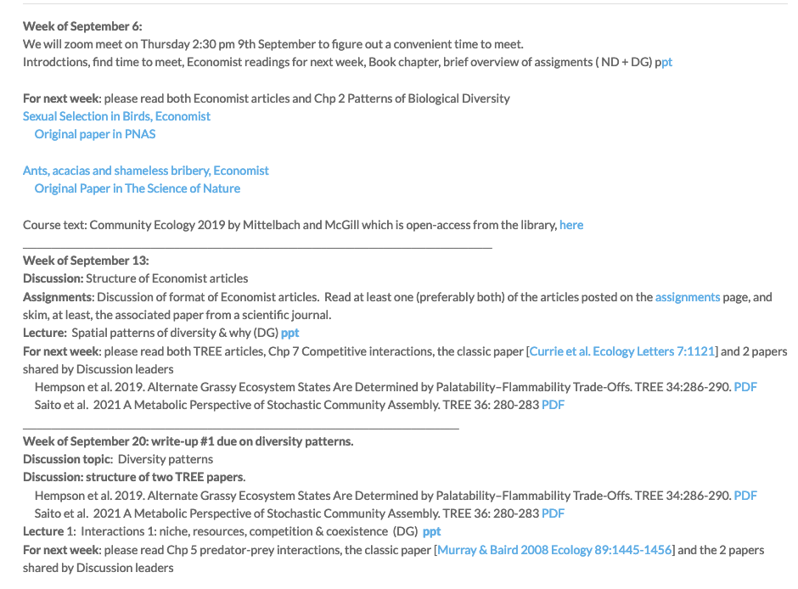
Course structure
Week_{t-1} Read relevant book chapter
Week_{t0} lecture will introduce a topic
Week_{t+1} discussion of modern classic and 2 modern corollaries w. Discussion Leaders.

Slide 25
Course structure
We will discuss a combination of modern classic and contemporary literature;
each (of the 2) discussion leaders to choose & circulate contemporary paper and a few relevant questions for discussion by midday Friday of week_{t}

Slide 26
First lecture next week
2 Discussion leaders: read classic and find and circulate a modern paper each with 3-5 thought-provoking questions
Everyone else: pick one of the modern papers, do a write up, submit to DG

Slide 27
Breaking it down
How to read
How to lead a discussion
And what about the big assignment at the end??

Slide 28
Why do you read & how do you read
Discuss

Slide 29
How to read
General: the three big questions to keep in mind
What did the author(s) do?
What are the hypotheses?
Why should we care?
Do you believe it?
What assumptions are made?
What is the experimental design, and is it appropriate?
What do the data say? Is the interpretation of the authors appropriate?
What is the significance of the work?
Notes:
Reading for courses and to generally keep up with the literature, vs. reading for your research program

Slide 30
The Big Questions, from Little and Parker
What is the mode of research?
What questions does the paper address?
c. What are the main conclusions of the paper?
d. What evidence supports those conclusions?
e. Do the data actually support the conclusions?
f. What is the quality of the evidence?
g. Why are the conclusions important?
http://www.biochem.arizona.edu/classes/bioc568/papers.htm

Slide 31
Reading process
Skim -- Read Title, Authors, Abstract and Discussion first, read figures and legends (determine relevance)
Vocabulary -- look up technical terms, flag new concepts (ie “risk reduction”, “model selection”) for further reading
Comprehension – the rest of the presentation
Reflection and analysis – can you describe the paper to someone else?

Slide 32
What makes a summary effective?
What would change for
a Scientific Audience?

Slide 33
The role of the Discussion Leader
Discussant is not world expert—just responsible for guiding discussion
Discussant circulates (via class email list) a list of 3-5 insightful questions along with the paper by Friday noon
In class, give short summary (3-5 min AT MOST) of the pair of papers to orient class, followed by the list of questions; try to engage your classmates rather than filling the time yourself
30 minutes per paper (so, 1-1.5 hrs discussion each week)

Slide 34
3-5 questions
What was the premise and core hypothesis?
What statistical inferential approach did the authors use?
We normally think about sexual selection and individual mating success, what was novel here?
How general is the finding?
What would the next obvious question / study be?

Slide 35
Weekly (ish) assignment: summarize one contemporary paper in 500 words
Example from The Economist

Slide 36
The TREE Forum paper
Some aspect of Community / Macroecology relevant to your PhD/MSc
Opportunity to discuss and develop topic in class week of Oct 4
Topic needs to be approved by DG/ND by week of Oct 11. Final paper about double-spaced, 1,200 words 12 references.
22 November: TREE Papers Due BY NOON; assigned for peer review by 5 PM
29 November: Peer review of papers returned to instructors by noon; AE recommendations within ~ 24 hours
6 December: Revised TREE paper due to both instructors by noon
In the style of TREE: TREE Forumare concise reviews of recent research in rapidly progressing or emerging areas. They should briefly set the background and then concentrate on setting recent findings in context.

Slide 37
Mark Breakdown
TREE paper, 35%
Your review of two TREE papers written by classmates: 10%
Weekly write-ups, 6% each * 5 = 30%
Discussion:
Participant 10%
Moderator 15%

