Slide 1
Biodiversity & Ecosystem Function
BISC 830
“We know that it has been experimentally shown that a plot of land will yield a greater weight if sown with several species and genera of grasses, than if sown with only two or three species.” Darwin & Wallace 1858

Slide 2
Basis for this area of enquiry
Loss of biological diversity is one of the most profound and irreversible changes to globe
Reductions in diversity, and corresponding changes in species composition could alter ecological processes and functions and ultimately services essential to humanity.
Three approaches / areas of enquiry
Grassland richness-function experiments
Diversity-stability / Portfolio effects
Simulations scaling up from empirical data

Slide 3
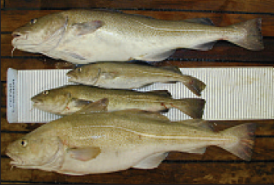
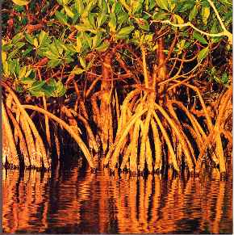
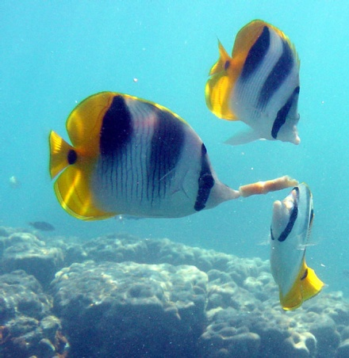
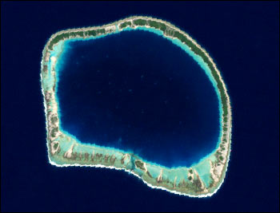
What is biodiversity?
Genes
Populations &
Species
Communities &
Ecosystems
Quantity
Variety
Distribution
Mace, G., Masundire, H., Baillie, J., Ricketts, T., & Brooks, T. (2005). Biodiversity. In Ecosystems and Human Well-being: Current State and Trends: Findings of the Condition and Trends Working Group (eds R. Hassan, R. Scholes & N. Ash), pp. 77-122. Island Press, Washington D. C.
Notes:
Millennium Ecosystem Assessment definition, Mace et al.
Mace, G., Masundire, H., Baillie, J., Ricketts, T., & Brooks, T. (2005). Biodiversity. In Ecosystems and Human Well-being: Current State and Trends: Findings of the Condition and Trends Working Group (eds R. Hassan, R. Scholes & N. Ash), pp. 77-122. Island Press, Washington D. C.

Slide 4
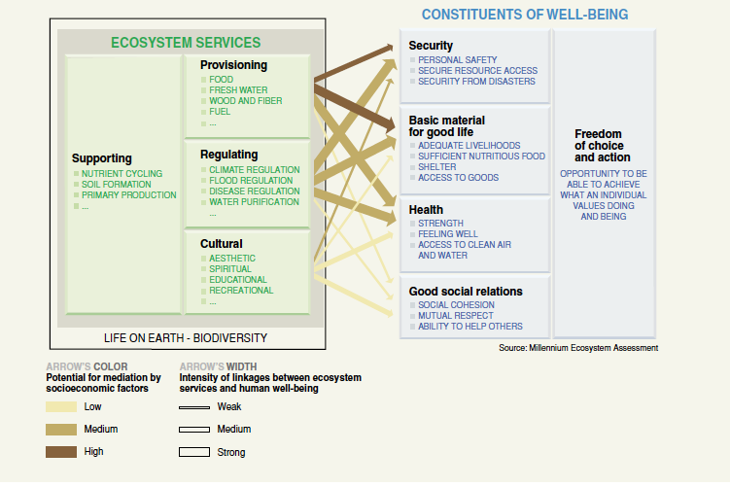
Millennium Ecosystem Assessment 2005

Slide 5
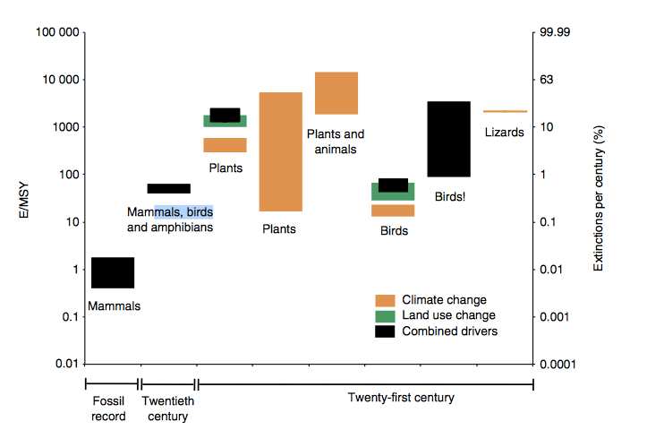
Pereira et al. 2010
Notes:
21 century – projected extinction rates under various scenarios e/MSY extinctions per million species years

Slide 6
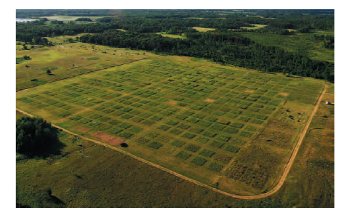
Cedar Creek Ecosystem Science Reserve
In 1993 David Tilman set-up 168 9m x 9m plots, seeded with 1, 2, 4, 8, 16 grassland-savanna perennial species drawn randomly from 18 species pool. Eventually expanded to 26-species.
Weeded to maintain treatment

Slide 7
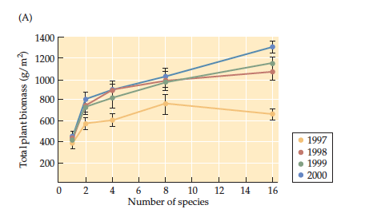
Cedar Creek Richness-Biomass

Slide 8
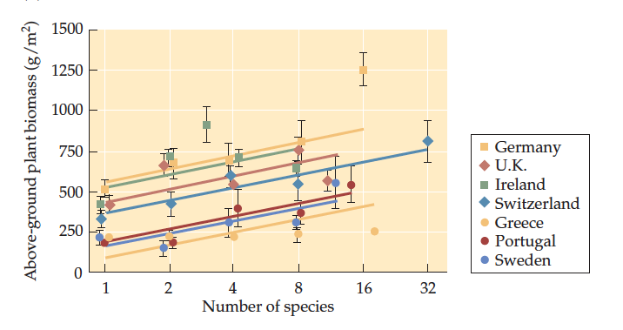
European BIODEPTH experiment Richness-Biomass (varying regional species pools)
Germany
Ireland
UK
Switzerland
Portugal
Sweden
Greece

Slide 9
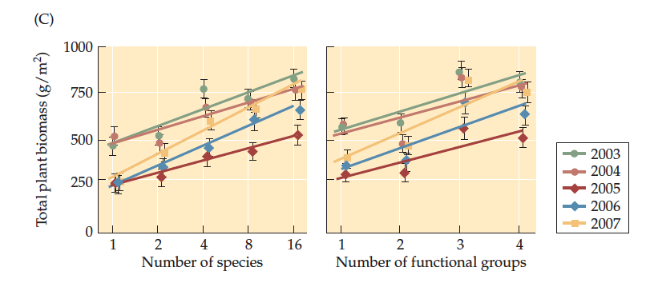
JENA Richness-Biomass 400 research plots established in a number of different experiments. For the main experiment, plant communities of 1-60 plant species and 1-4 plant functional groups.

Slide 10
Three mechanisms underlying this effect
Facilitation presence of one species enhance performance of another
Niche complementarity
Species selection (the statistical sampling effect)
More species-rich communities are more likely to contain more-productive species that come to dominate the community

Slide 11
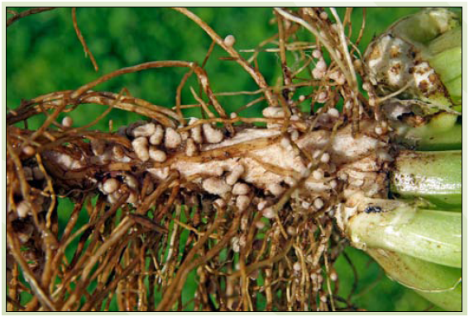
1. Facilitation
Some species alleviate environmental conditions or provide a resource for other species, e.g. legumes harbour nitrogen-fixing Rhizobia bacterial nodules

Slide 12
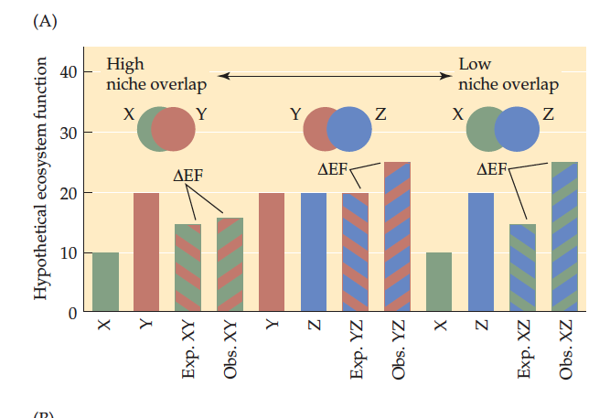
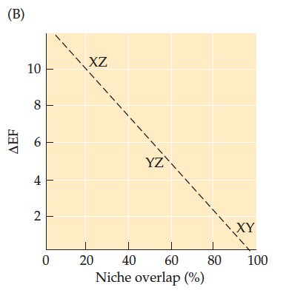
2. Niche Complementarity
Low niche
overlap
high
Mixtures of species with LOW niche overlap (large difference in their resource requirements) should have a greater impact on ecosystem functioning △EF, i.e. difference between mean expectation [XY] and observed [XY]
Expectation for mixture is average of monocultures

Slide 13
Greenhouse study --- Evidence for
complementarity or facilitation
^
Species grown in monoculture
EFFECT = LRm
Log(All)-Log(best performing species)
When LRm > 0
Increase is due to complementarity or facilitation
Polyculture of all
^
Property or service
1 All
Species Richness

Slide 14
Greenhouse study --- Evidence for statistical sampling effects
^
EFFECT = LRm
Log(All)-Log(best 1)
If LRm = 0
Increase is due to sampling
Function increases with diversity because the chance of having an effective species increases
^
Property or service
1 All
Species Richness

Slide 15
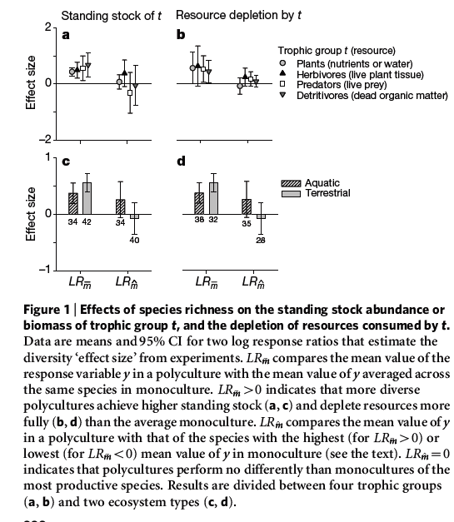
Metaanalysis of 111 field, greenhouse and laboratory experiments
_
LRm = mean value of most species-rich polyculture divided by MEAN of those species in monoculture
LRm > 0 indicates more diverse polycultures achieve higher standing stock/resource depletion.
LRm = mean value of most species-rich polyculture divided by the best species - with the highest (lowest) value in monoculture. Zero means polycultures no better than the best monocultured species.
_
^

Slide 16
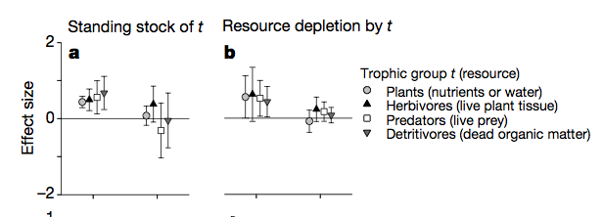
Meta-analysis 1 revisited
Cardinale (2006) suggests that sampling effects are a common explanation for increased function
Cardinale et al. 2006 Nature

Slide 17
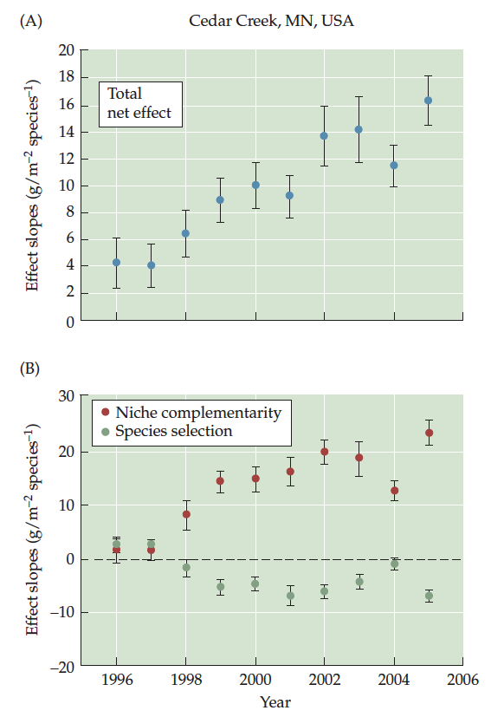
Species selection important initially,
Later complementarity becomes
more important over time
The species selection /sampling effect dwindles over time because the the species that eventually dominate the mixtures are not the same species that give highest yield in monoculture

Slide 18
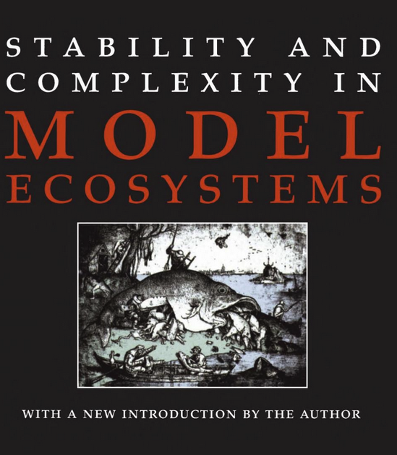

Slide 19
Stability-diversity debate
MacArthur, Elton & Odum they argued that more diverse communities should be better buffered against species extinction, invasions & perturbations
Bob May -- Diversity doesn’t begat stability in network models, instead a species-rich community of competitors are less likely to return to equilibrium after perturbation
McCann-Rooney networks stabilized by weak interactions (e.g., 6 degrees of separation/Bacon game)

Slide 20
Tilman temporal stability-diversity relationship
Temporal stability of a species S_{i} is mean abundance µ_{I} divided standard deviation in abundance σ_{i} as µ_{I} / σ_{i}
Temporal stability of the total community S_{T}
Hence, richness can affect stability through
Increasing species abundance (i.e. overyielding)
Decreasing summed variance (i.e. Portfolio effect)
Decreasing summed covariance (i.e. Complementarity)

Slide 21
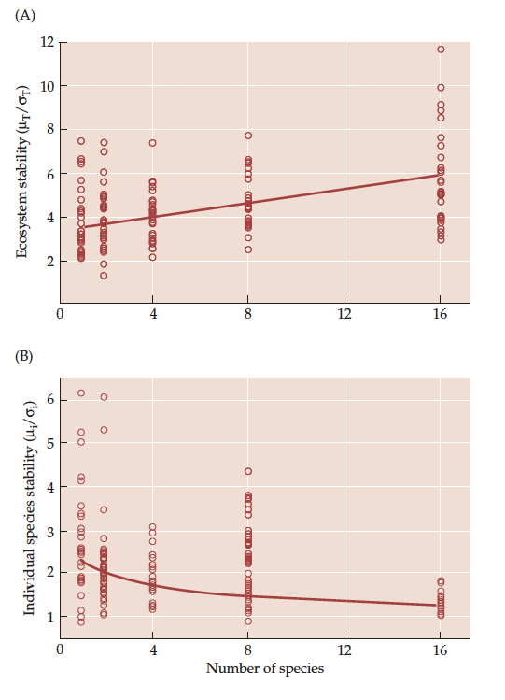
Increasing community stability in species rich plots…
…but reduced temporal stability in individual species

Slide 22
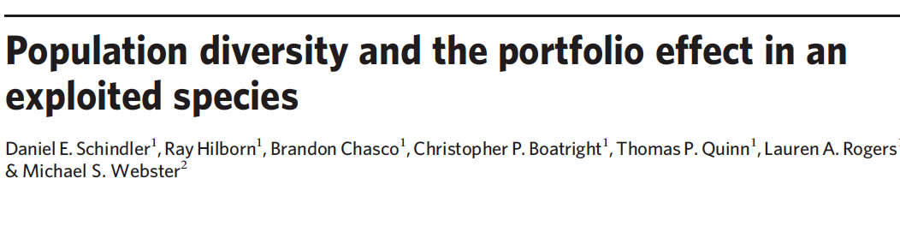
Portfolio effect
This is the reduction in stability simply due to accumulation of randomly fluctuating species (financial stocks), Schindler et al.
The PE is the degree to which diversity reduces variability, Moore et al., Nesbitt et al.

Slide 23
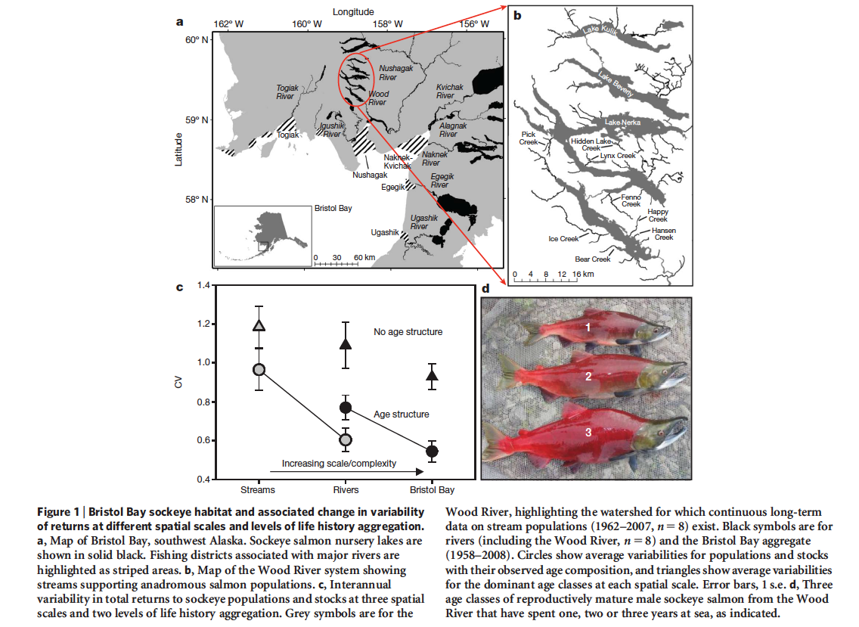
Returns to Bristol Bay are 2.2 times less variable than might be expected if comprised of a single homogeneous stock

Slide 24
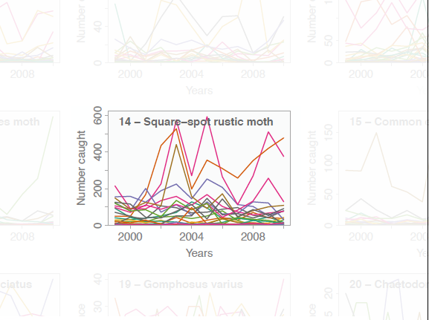
Anderson, S.C., et al. (2013).
Ecological prophets: quantifying metapopulation portfolio effects.
Methods in Ecology and Evolution, 4, 971–981.

Slide 25
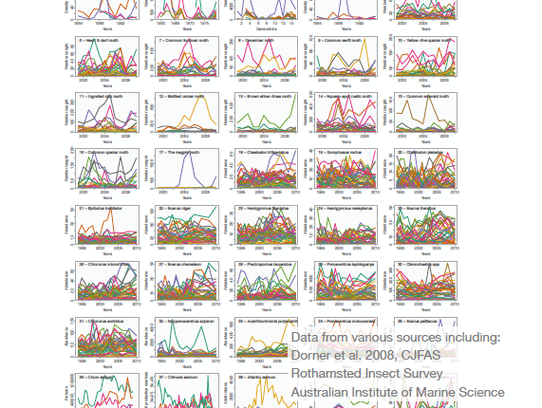
Each panel = metapopulation
Each line = population

Slide 26
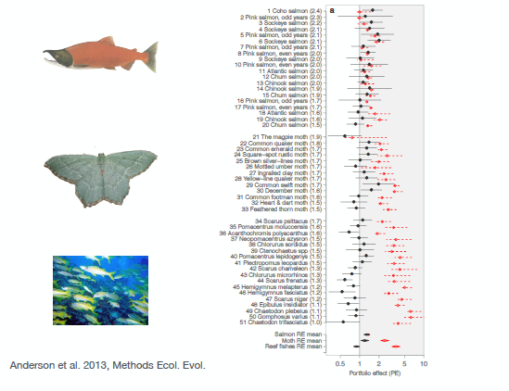
Mean-variance method
Average CV method

Slide 27
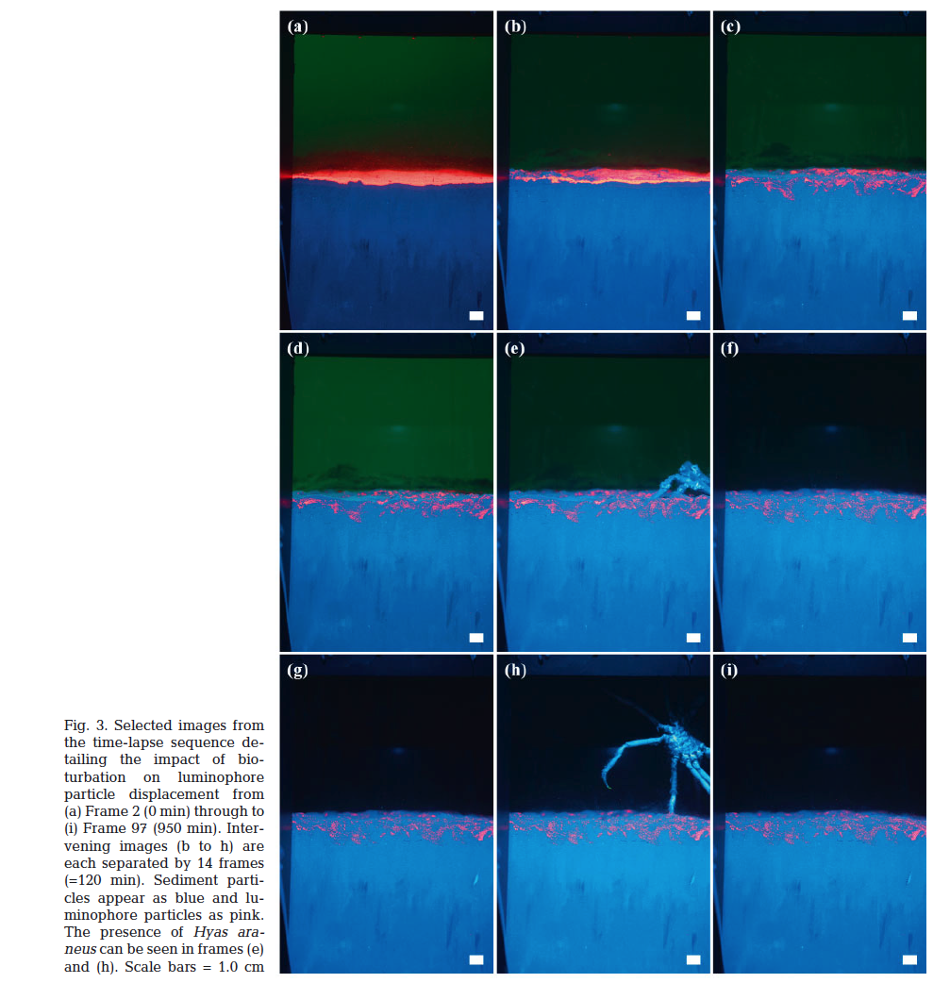

Slide 28
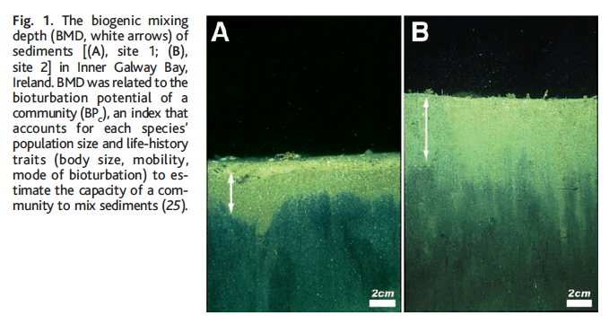
Functional trait-based simulation model of BD loss
Solan, M., Cardinale, B.J., Downing, A.L., Engelhardt, K.A.M., Ruesink, J.L. & Srivastava, D.S.
(2004). Extinction and ecosystem function in the marine benthos. Science, 306, 1177

Slide 29
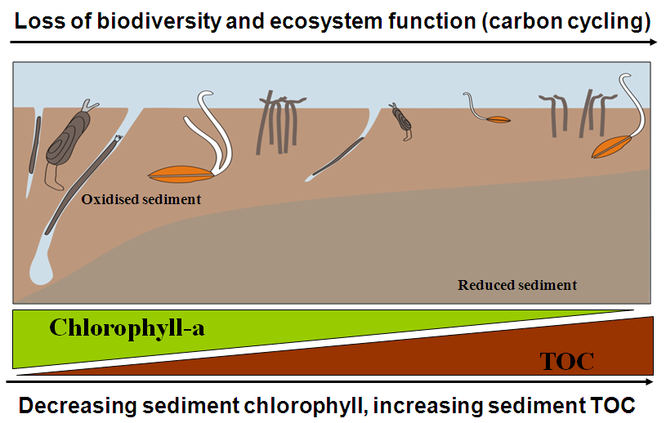

Slide 30
Bioturbation Index of each species
BP_{i} = B_{i} x M_{i} x R_{i}
B_{i} = Mean body size g
M_{i} = Mobility, propensity to move through sediment
1 = in a fixed tube,
2 = limited movement, sessile, but not in tube,
3 = slow movement through sediment,
4 = free movement via burrow system
R_{i} = Reworking

Slide 31
R_{i} = Reworking
epifauna that bioturbate at the sediment-water interface;
surficial modifiers, whose activities are restricted to <1-2 cm of the sediment profile;
head-down/head-up feeders that actively transport sediment to/from the sediment surface;
biodiffusers whose activities result in a constant and random diffusive transport of particles over short distances; and
regenerators that excavate holes, transferring sediment at depth to the surface).

Slide 32
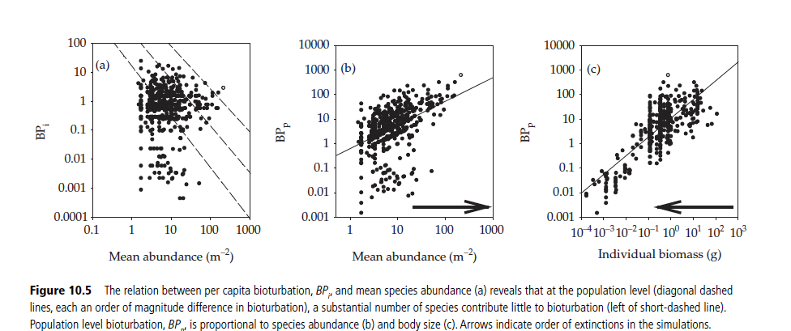
Per capita
bioturbation potential
Population bioturbation potential

Slide 33
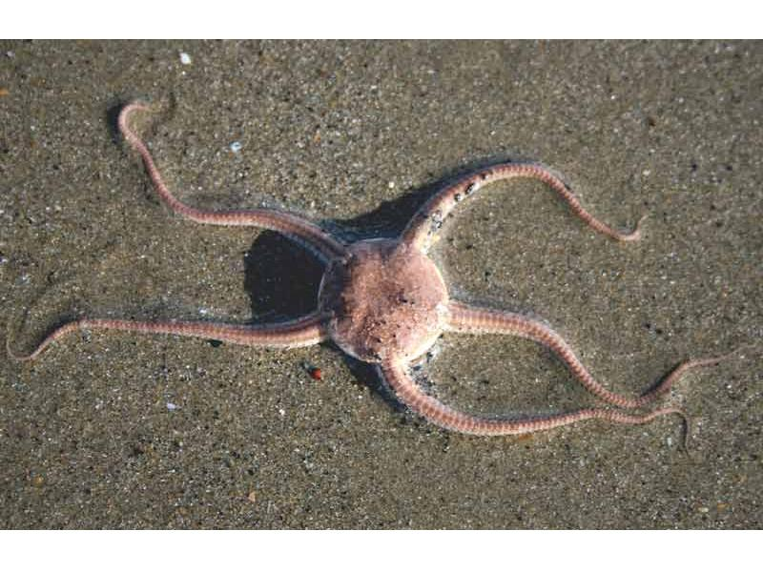

Slide 34
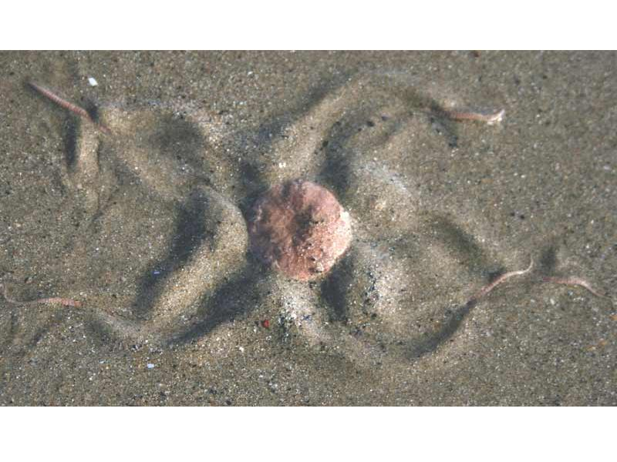

Slide 35
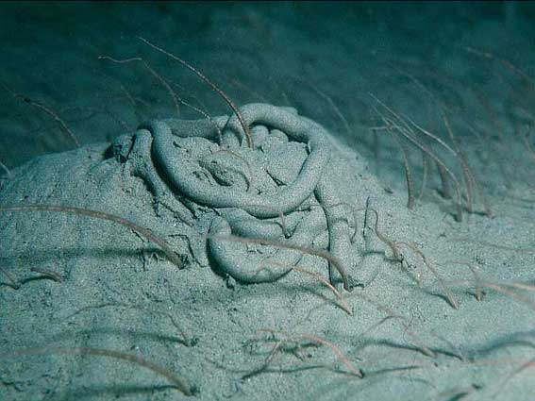

Slide 36
Scaling up to community function
BPcommunity = sum of
Abundance_{a} * Bp_{a}
Abundance_{b} * BP_{b}
Abundance_{c} * BP_{c}
Abundance_{d} * BP_{d}
Abundance_{e} * BP_{e}
Abundance_{f} * BP_{f}
Abundance_{g} * BP_{g}
…
ABUNDANCDE is key determinant of ecosystem function

Slide 37
Generate relationship between BP community and observed biogenic mixing depth

Slide 38
Running simulation
1. Kill species (at random, by body size, rarity, etc.)
Abundance_{a} * Bp_{a}
Abundance_{b} * BP_{b}
Abundance_{c} * BP_{c}
Abundance_{d} * BP_{d}
Abundance_{e} * BP_{e}
Abundance_{f} * BP_{f}
Abundance_{g} * BP_{g}
2. Recaculate BPcommunity
3. Calculate Biogenic Mixing Depth

Slide 39
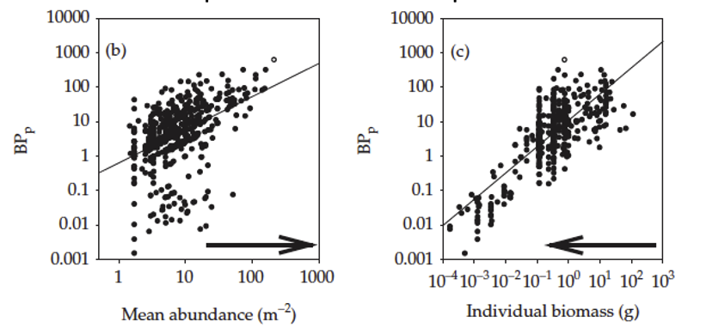

Slide 40
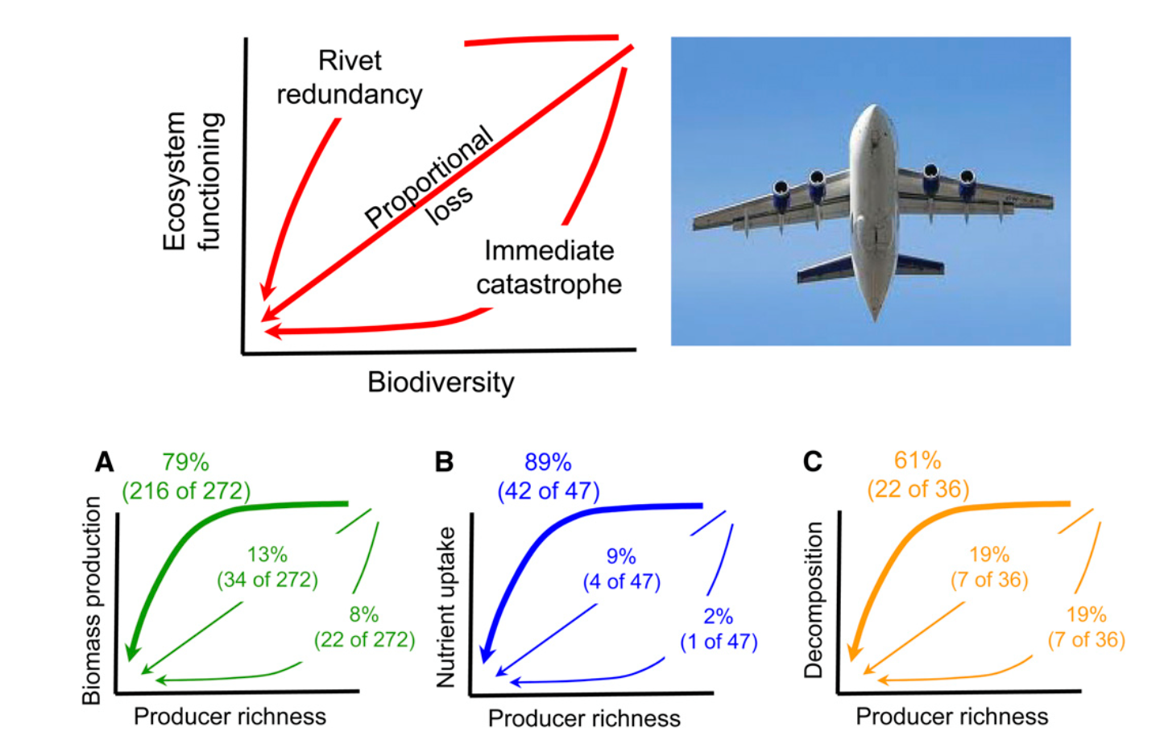
Biodiversity and Ecosystem function
How many species do we need? Cardinale et al. 2011

Slide 41
Summary
Experiments suggest that loss of biodiversity is detrimental to ecosystem function
Increased function can be due to sampling effects, complementarity and facilitation
Cardinale et al. (2011) suggests that current data supports a rivet-redundancy model for effects of biodiversity loss
Experiments, so far, have been criticized because they are unrealistic (ie they use limited species combinations, and/or focus on one trophic level) and/or operate on a short timeline
Functional trait simulations reveal non-linearities and acceleration at low BD; ABUNDANCE & SIZE is important

Slide 42
Readings
Anderson, S.C., Cooper, A.B. & Dulvy, N.K. (2013). Ecological prophets: quantifying metapopulation portfolio effects. Methods in Ecology and Evolution, 4, 971–981.
Cardinale, B.J., Matulich, K.L., Hooper, D.U., Byrnes, J.E., Duffy, E., Gamfeldt, L. et al. (2011). The functional role of producer diversity in ecosystems. American journal of botany, 98, 572-592.
Cardinale, B.J., Duffy, J.E., Gonzalez, A., Hooper, D.U., Perrings, C., Venail, P. et al. (2012). Biodiversity loss and its impact on humanity. Nature, 486, 59-67.
Millennium Ecosystem Assessment (2005). Ecosystems and Human Well-being: Biodiversity Synthesis. World Resources Institute Washington, DC, p. 86.
Nesbitt, H.K. & Moore, J.W. (2016). Species and population diversity in Pacific salmon fisheries underpin indigenous food security. Journal of Applied Ecology, 53, 1489-1499.
Pereira, H.M., Leadley, P.W., Proenca, V., Alkemade, R., Scharlemann, J.P.W., Fernandez-Manjarres, J.F. et al. (2010). Scenarios for global biodiversity in the 21st century. Science, 330, 1496-1501.
Schindler, D.E., Hilborn, R., Chasco, B., Boatright, C.P., Quinn, T.P., Rogers, L.A. et al. (2010). Population diversity and the portfolio effect in an exploited species. Nature, 465, 609-612.
Solan, M., Cardinale, B.J., Downing, A.L., Engelhardt, K.A.M., Ruesink, J.L. & Srivastava, D.S. (2004). Extinction and ecosystem function in the marine benthos. Science, 306, 1177.
Stachowicz, J.J., Whitlatch, R.B. & Osman, R.W. (1999). Species diversity and invasion resistance in a marine ecosystem. Science, 286, 1577-1579.
Tilman D, Downing JA. 1994. Biodiversity and stability in grasslands. Nature 367:363-365.

Slide 43
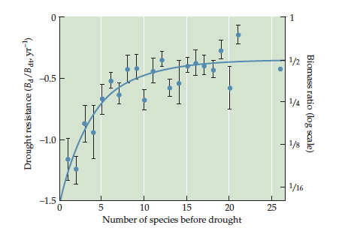
Higher species richness is associated with higher biomass in face of drought Tilman & Downing 1994
Drought resistance is change in biomass compared to previous year
Proportional loss

Slide 44
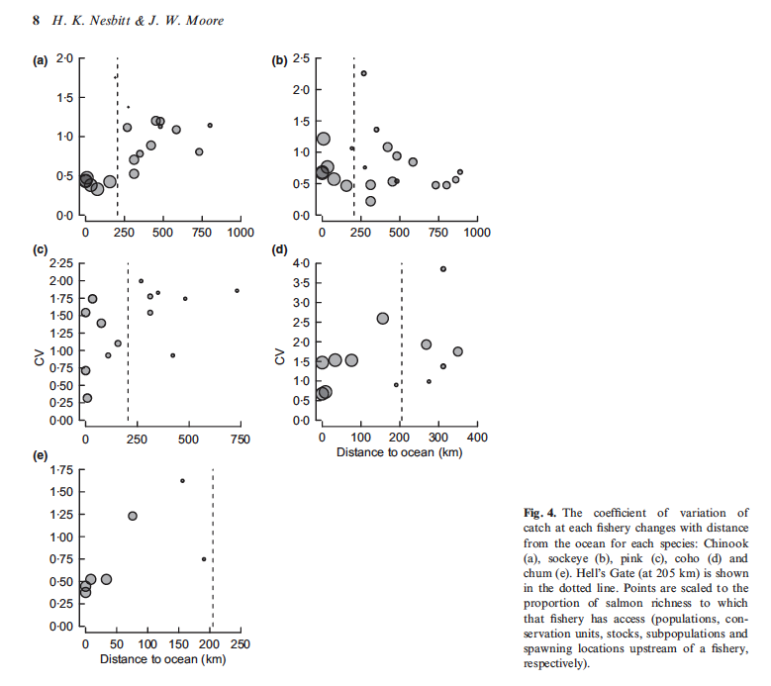
Chinook
Sockeye
Pink
Coho
CV of catch
Chum

Slide 45
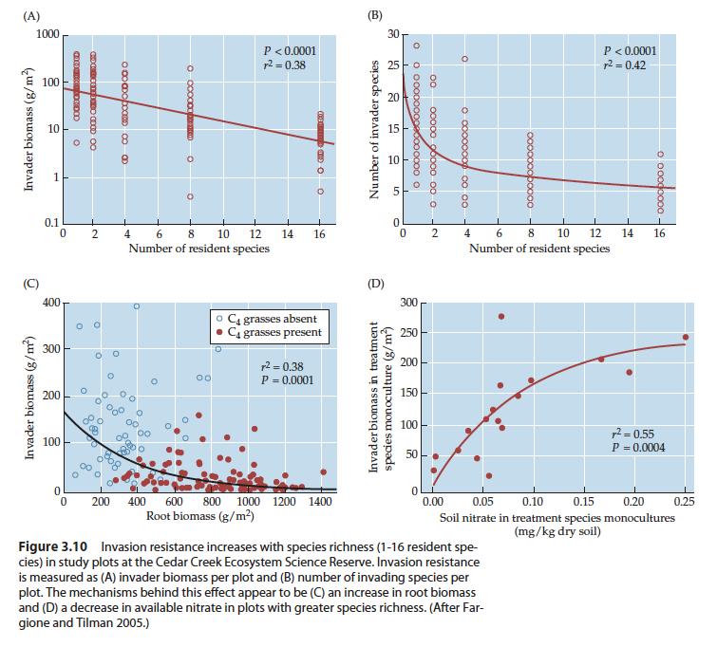
Cedar Creek ecosystem experiment

Slide 46
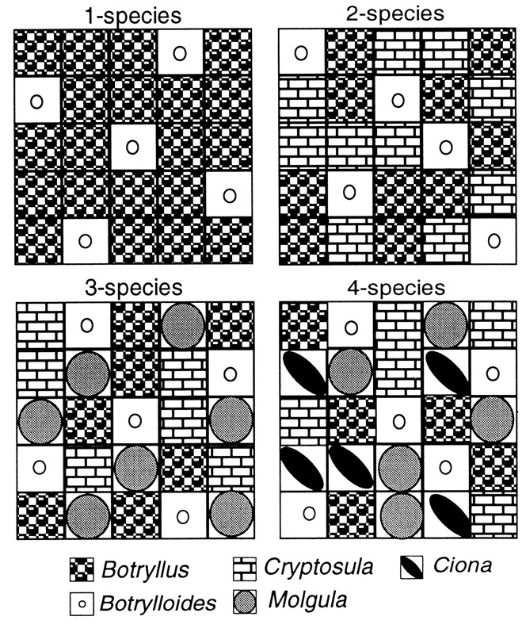
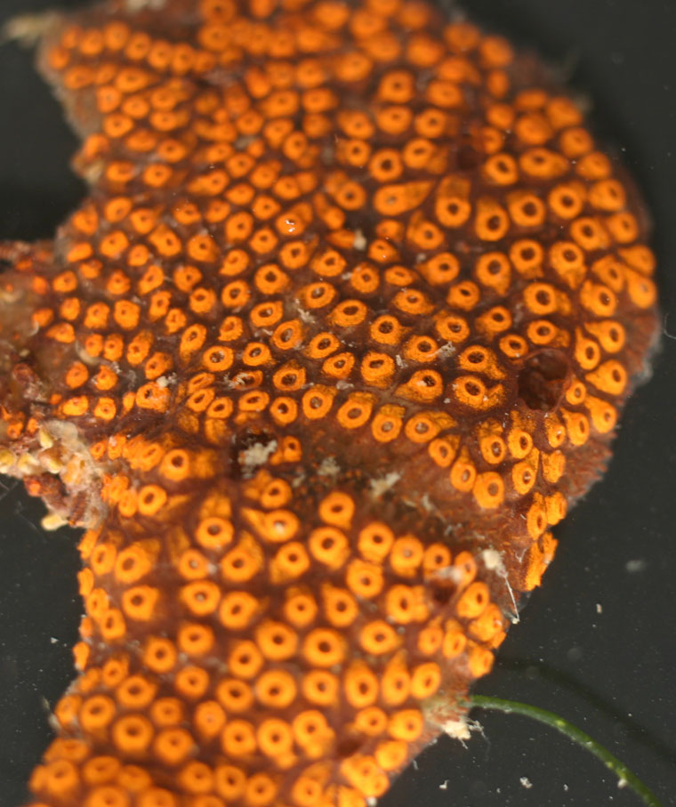
25 x 2 cm² tiles, each of monoculture, bolted together to form a community
John J. Stachowicz et al. Science 1999;286:1577-1579

Slide 47
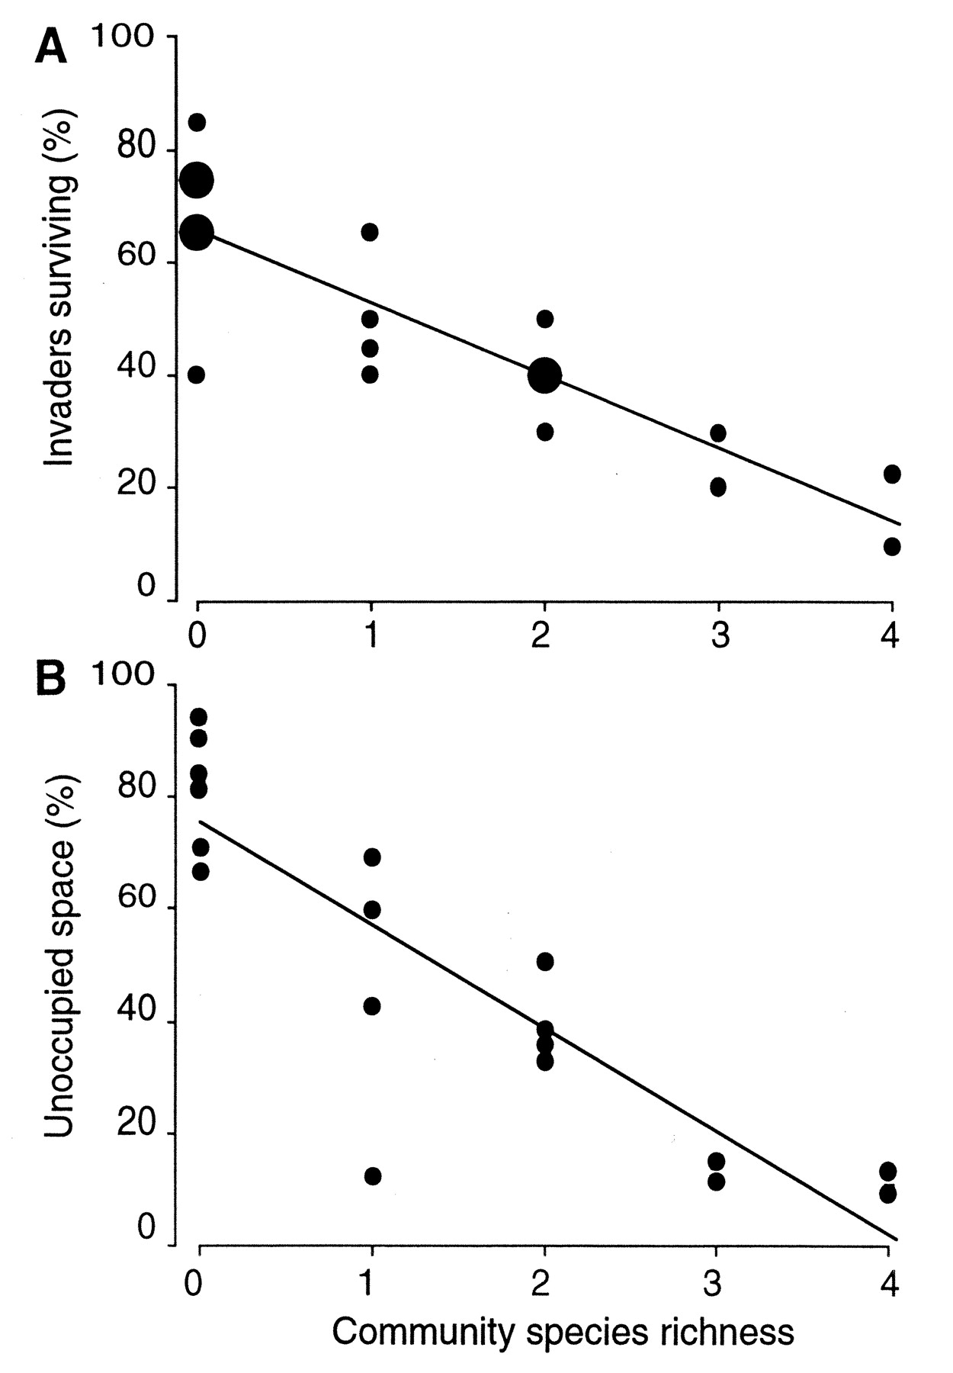
Invasion resistance

